Slide 1


Simon Nachevski 19.12.2023

Slide 2
Outline
Executive Summary
Introduction
Methodology
Results
Conclusion

Slide 3
Methodology
Data Collection Methodology:
Collect SpaceX API rocket launch data
Data Wrangling
Create and modify columns for further use
Perform exploratory data analysis (EDA) using visualization and SQL
Perform interactive visual analytics
Perform predictive analysis using classification models
Split dataset into training and testing data
Develop machine learning models such as KNN, Decision Trees, Logistic Regression and SVM
Train and evaluate the models
3

Slide 4
Introduction
Space Exploration companies can spend up to $165 million per launch
SpaceX have cut their costs up to $62 million per launch
With the recovery of the Stage One part of the rocket, which is a very expensive part
But not always…

Slide 5

9

Slide 6
Methodology
Data Collection Methodology:
Collect SpaceX API rocket launch data
Data Wrangling
Create and modify columns for further use
Perform exploratory data analysis (EDA) using visualization and SQL
Perform interactive visual analytics using Folium and Plotly Dash
Perform predictive analysis using classification models
Split dataset into training and testing data
Develop machine learning models such as KNN, Decision Trees, Logistic Regression and SVM
Train and evaluate the models
6

Slide 7
Data Collection
Data Collection Methodology
Download SpaceX data using the SpaceX API
Create a dataframe for further use
Clean the data

Slide 8
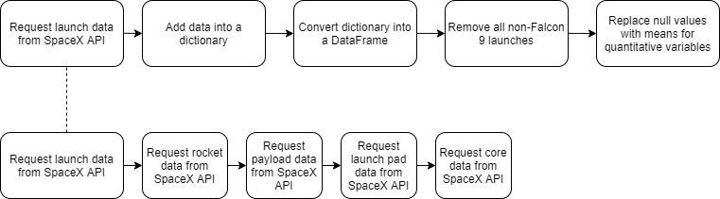
Data Collection – SpaceX API
GitHub

Slide 9
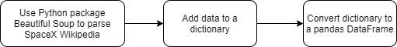
Data Collection - Scraping
GitHub

Slide 10
Data Wrangling
Determine whether the launch was successful or not
From the dataframe, 8 possible outcomes can be defined:
True ASDS: Successful landing to a drone ship
True RTLS: Successful landing on a ground pad
True Ocean: Successful landing in the ocean
None None: Failed to land
None ASDS: Failed to land
False ASDS: Failed to land on a drone ship
False RTLS: Failed to land on a ground pad
False Ocean: Failed to land in the ocean
10

Slide 11
Data Wrangling
The Stage One recovery data is split in new columns depending on the recovery:
1 – Successful Recovery
0 - Failed

Slide 12
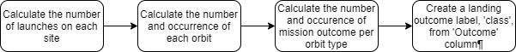
Data Wrangling
GitHub

Slide 13
EDA with Data Visualization
Plots of relationships within variables:
Cat plot of Flight Number and Payload
Cat plot of Flight Number and Launch Site
Scatter plot of Launch Site and Payload
Bar plot of Success Rate and Orbit type
Scatter plot of Orbit type and Flight Number
Scatter plot of Orbit type and Payload
Line plot of Success rate and Time (Years)

Slide 14
EDA with SQL
With the help of SQL, we make some basic queries on our data to get a better sense for the relationships between variables, particularly the following:
Launch Site
Payload Mass in kg
Mission Outcome
Booster Version
Date
GitHub

Slide 15
Build an Interactive Map with Folium
With Folium, an interactive map has been created in which you can:
Falcon 9 launch sites as circles
Launches by location, represented by markers. Green markers are successful recoveries. Red markers are unsuccessful recoveries
Distances to closest coastlines , cities, railways and highways, shown as a blue line
GitHub
15

Slide 16
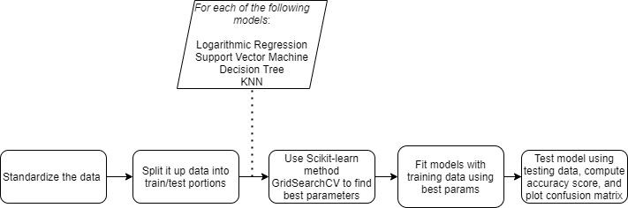
Predictive Analysis
GitHub

Slide 17
Results
EDA Results:
SpaceX has gotten better at launching rockets overtime. Launches are most successful when launched in 2017 or later
Light payloads are evidently easier to recover, as most successful recoveries occur when the payload has a mass between 2000kg and 4000kg)
Launch site KSC LC-39A appears to be ideal as it has a success rate of over 75%
The best recovery method is through drone ships

Slide 18


Slide 19
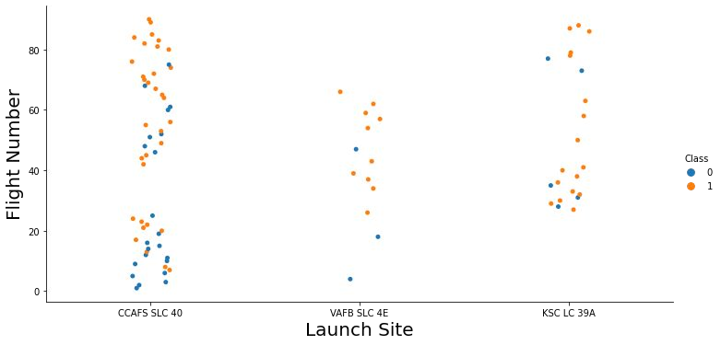
EDA with Data Visualization
Flight Number vs Launch Site (Cat Plot)
KSC LC-39A seems to be the most consistent launch site

Slide 20
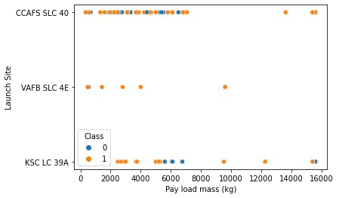
EDA with Data Visualization
Launch Site vs Payload Mass (Scatter Plot)
The smaller the payload, the higher the success rate

Slide 21
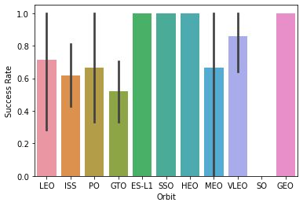
EDA with Data Visualization
Success Rate vs. Orbit Type (Bar plot)
The ES-L1, SSO, HEO, and GEO orbits are very reliable

Slide 22
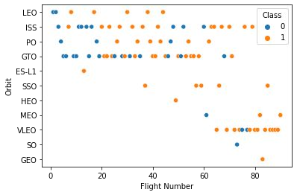
Flight Number vs. Orbit Type
ES-L1, HEO, and GEO success rates are skewed due to each having only 1 launch
LEO, SSO, and VLEO have higher success rates and higher number of samples

Slide 23
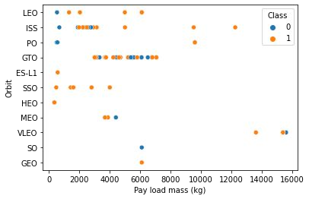
Payload vs. Orbit Type
LEO and SSO orbits’ success may be due to light payloads

Slide 24
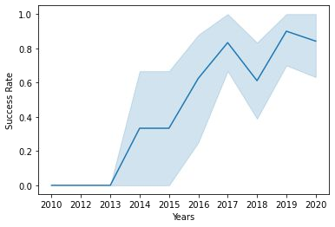
Launch Success Yearly Trend
Overall success rate increased the most from 2013 to 2017
Since 2017, the success rate has lowered

Slide 25
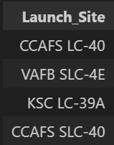
Launch Sites
There are four launch sites:

Slide 26
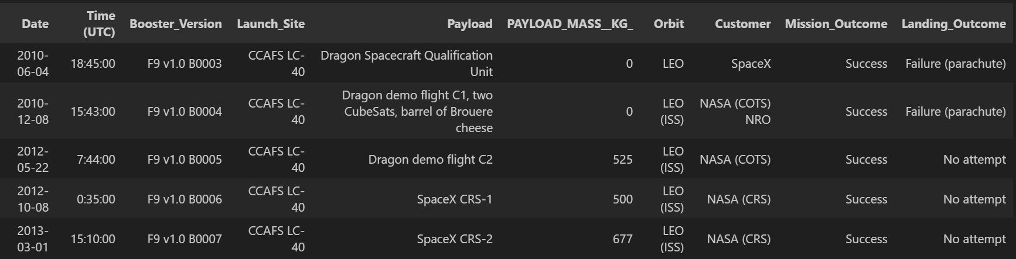
Launch Site Names Begin with 'CCA'
First 5 records for launch sites that begin with ‘CCA’:

Slide 27
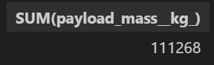
Total Payload Mass
Here is the total payload mass (in kg) carried by boosters from NASA:

Slide 28
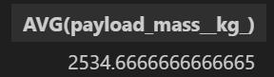
Average Payload Mass by F9 v1.1
On average, rockets with by booster version F9 v1.1 carry a mass of 2534,66

Slide 29
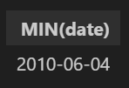
First Successful Ground Landing Date
The first successful Stage One recovery landing occurred on:

Slide 30
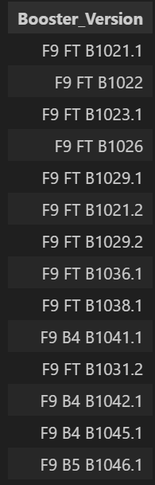
Successful Drone Ship Landing with Payload between 4000 and 6000
This is a list of the names of boosters which have successfully landed on a drone ship and had payload mass greater than 4000kg but less than 6000kg

Slide 31
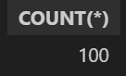
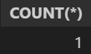
Total Number of Successful and Failure Mission Outcomes
In total, there were 101 missions recorded in this database, which were either:
Success
Failure

Slide 32
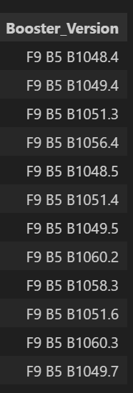
Boosters Carried Maximum Payload
List of the names of boosters which have carried the maximum payload mass:

Slide 33
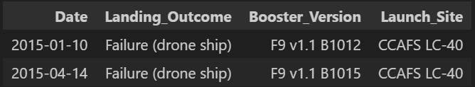
2015 Launch Records
In 2015, there were two launches which resulted in a failed Stage One recovery:

Slide 34
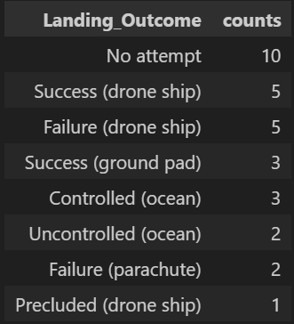
Rank Landing Outcomes Between 2010-06-04 and 2017-03-20
Rank of the types and number of landing outcomes between dates 2010-06-04 and 2017-03-20:

Slide 35


Slide 36
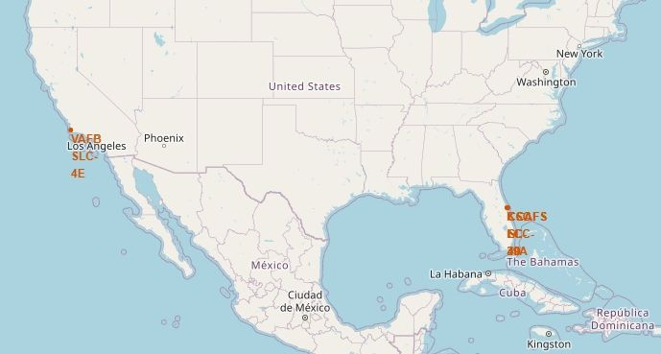
Map of Launch Site Locations
As can be seen, SpaceX has one launch site on the Pacific coast of Southern California
The rest of the launch sites are located on the Atlantic coast of Florida

Slide 37
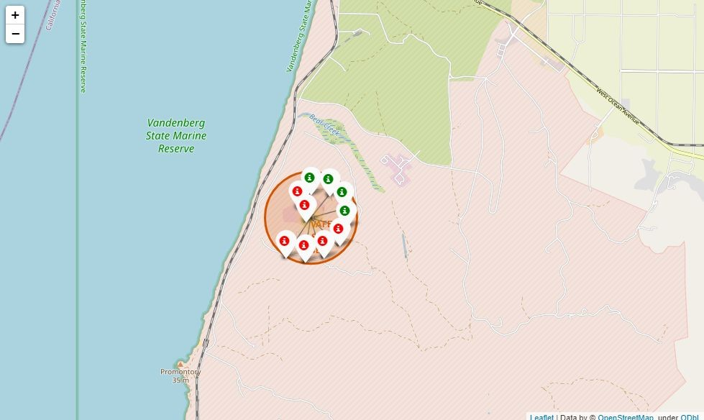
VAFB SLC-4E Recovery Outcomes
The markers represent a Falcon 9 Stage One recovery
Green is a successful recovery
Red is an unsuccessful recovery

Slide 38
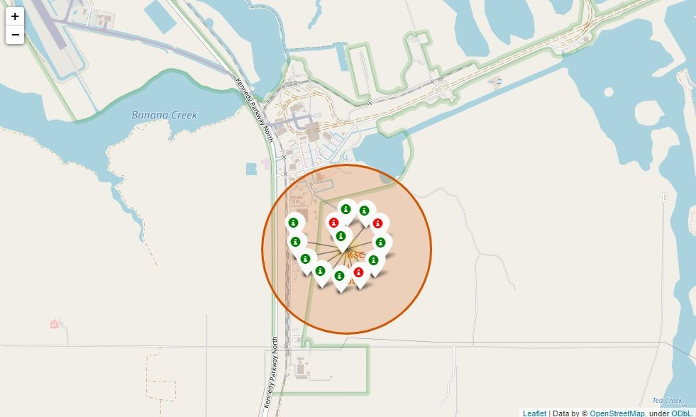
KSC LC-39A Recovery Outcomes

Slide 39
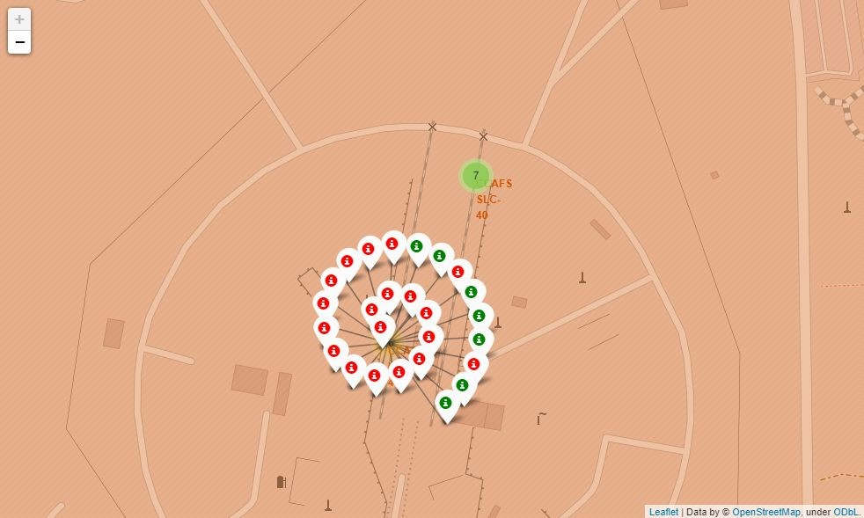
CCAFS LC-40 Recovery Outcomes

Slide 40
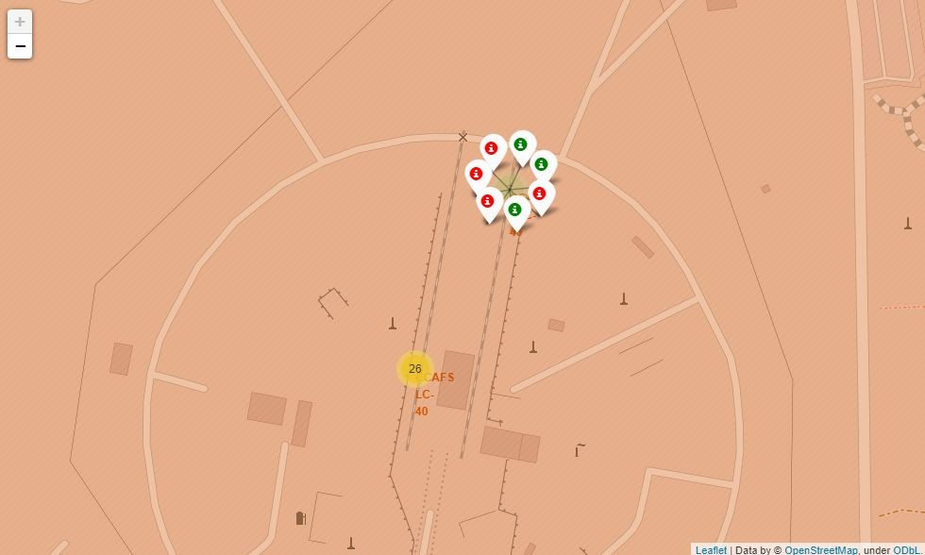
CCAFS SLC-40 Recovery Outcomes

Slide 41
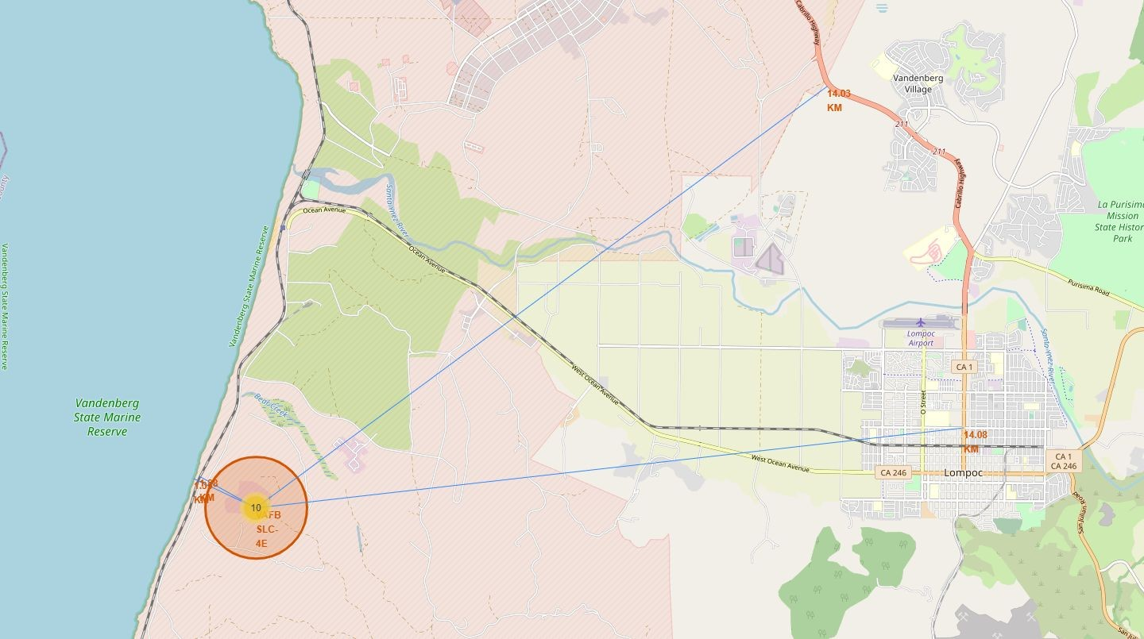
VAFB SLC-4E Nearby Locations
Each blue line represents the distance to the nearest
Coastline
City
Railway
Highway

Slide 42
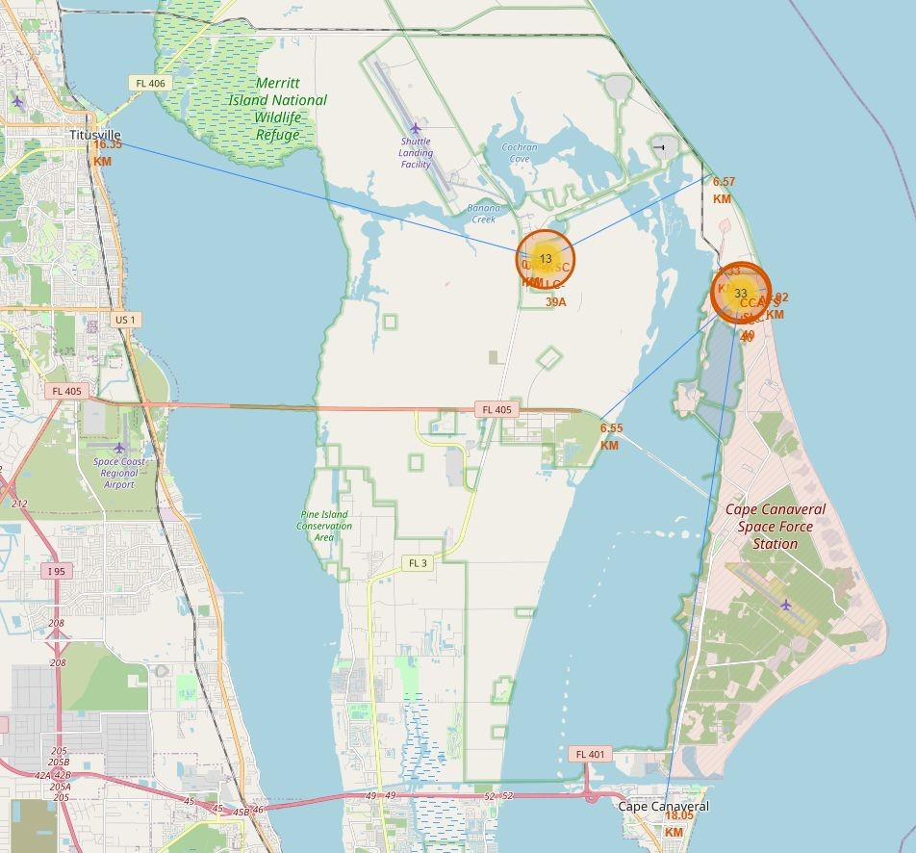
KSC LC-39A, CCAFS LC-40, and CCAFS SLC-40 Nearby Locations
Less than 15km distance to the nearest towns
Launch sites located less than 7km to the coast and surprisingly close to railways and highways

Slide 43


Slide 44
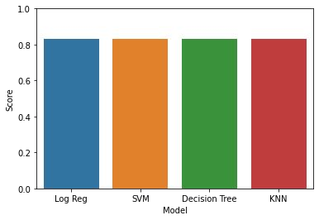
Classification Accuracy
The bar plot shows the accuracy of the different classification models
All models have an accuracy rate of 83,33%

Slide 45
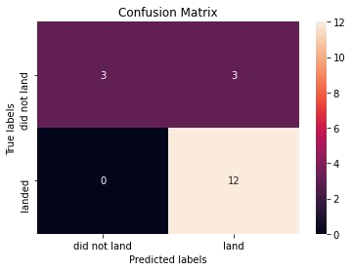
Confusion Matrix
The model had good predictions
Although it had good predictions, there were some cases in which it could not predict correctly

Slide 46
Conclusions
From all of the successful recoveries, these properties were the most common ones:
A launch date in the year 2017 or later
A payload in the range from 2000 up to 4000kg
KSC LC-39A launch site
Drone ship successful recovery
The models predict the outcome with a success rate of 83.33%

Slide 47


